Slide 1
Cloud Computing Group
Nisser Aldossary, Hayley Carter, Guzel Noori, Ryan Perkins

Slide 2
Overview
Backend
Frontend
Testing
Security

Slide 3
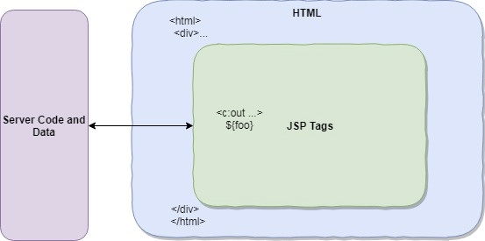
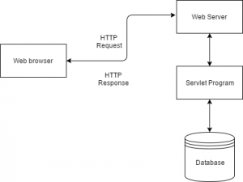
Backend
Tools used: Java Server Pages, Java Servlets
Language: Java
IDE: Eclipse

Slide 4
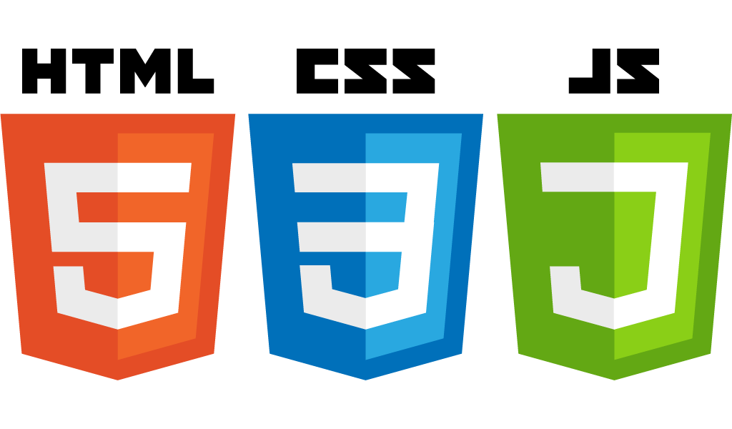

Frontend
What is front end?
Converting data to a graphical interface using HTML, CSS, JavaScript so that the users can view and interact with the website.
Tools used
Languages: HTML, CSS, Bootstrap, JavaScript, JQuery
*Bootstrap 4: Open Source CSS framework directed for front-end development.
IDE: Visual Studio Code

Slide 5


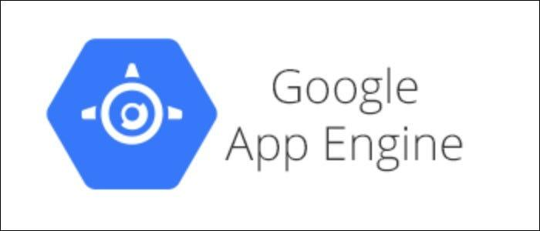
Frontend (contd.)
Website UI is compatible with all browsers
Manual testing: Google Chrome
Later deployed to Google App Engine

Slide 6

Testing
Junit testing
Fully unit-testing for backend functions "DatabaseController class"
Database queries and Connections
Manual testing during development for individual features
front-end manual testing all throughout the development to make it understandable and useful for any user

Slide 7

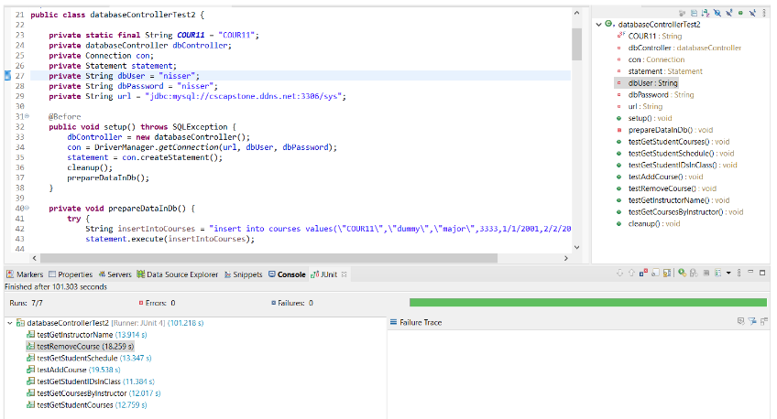
Unit tests passing

Slide 8
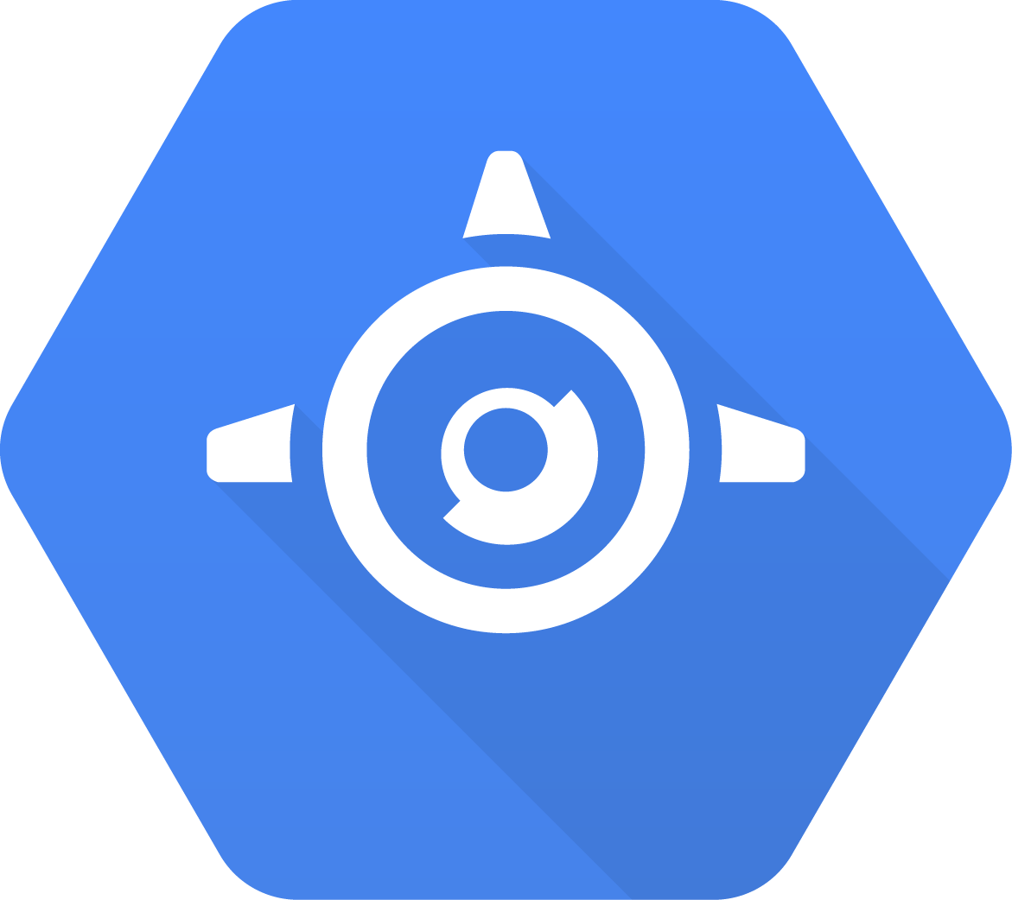
Security
Google App Engine handles a lot of security stuff for us
SQL server can only be accessed by the app and it’s administrators
Source code is never provided to the end user, only the frontend web page
This means we can hard-code database access into the backend
GAE has built-in SSL we have configured to be forced for all users
GAE also has built-in protections to block malicious IPs
GAE security scanner crawls our webpages and seeks out vulnerabilities and notifies us of any we missed
Login and User Data changing functions require proper login information
Password changes require old password and userID
Password resets are performed by faculty only, with temporary passwords sent to students via email
Input data is used in prepared statements to help prevent SQL injection

Slide 9
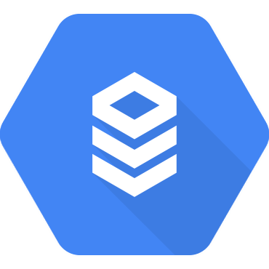
Security (Continued)
Logins are encoded with SHA-512
Generated with Java’s inbuilt MD system
Hashes are salted with a randomly generated 16 byte salt
Even if the database is able to be accessed, it will be difficult to crack
Database is CloudSQL (run by Google)
Configured with request cooldown to prevent spam
Comes with inbuilt SQL Injection protection
Ingress protection prevents non-GAE usage
Bottomline: A Hacker would have to gain access to google’s servers, acquire our source code, modify the client, push the changes to GAE, and then use it to access our database in order to get user info

Slide 10
Thank You For Watching!

